Slide 1
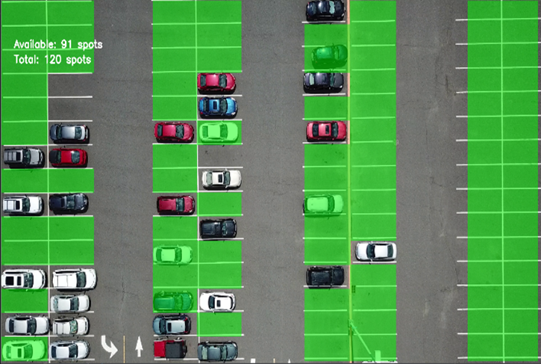
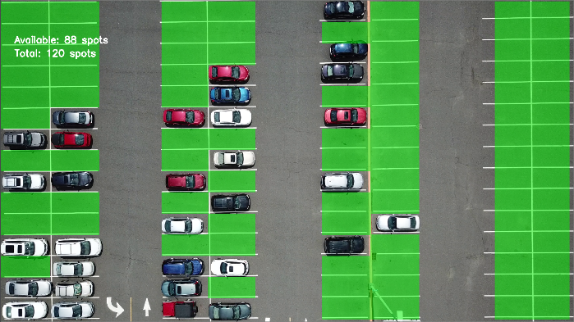
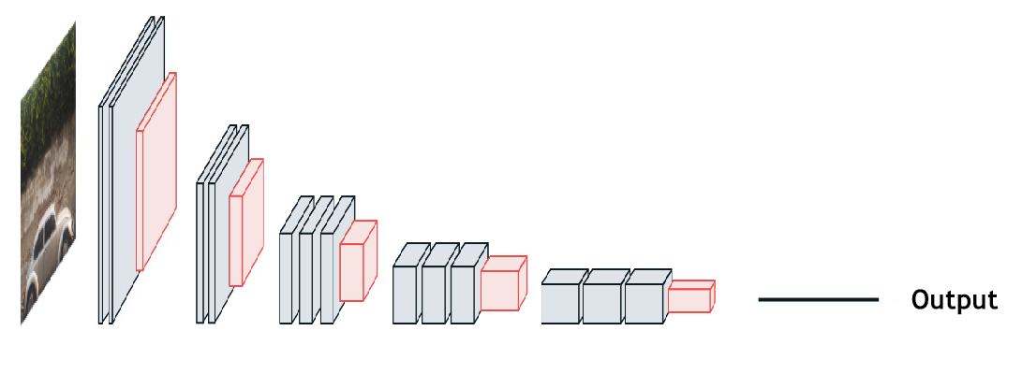
Optimal Deep Learning Neural Network Designs
Gabriel A. Lopez Lugo
University of Puerto Rico at Mayaguez
gabriel.lopez23@upr.edu
Abstract
Method
Results
Deep Learning (DL) using Neural Networks (NN) has been very successful in many applications involving image recognition, language processing, and other fields. Yet, there persists the question of how to create an optimized and accurate DL NN model. For instance, accuracy relies on the quality and quantity of the data and the various hyper-parameters of the NN. To investigate the principles of DL, we designed and conducted experiments with a pre-trained CNN that distinguishes between empty and occupied parking spots. The available dataset for our CNN was considerably modest, and even with data augmentation, its performance needed improvement. To enhance our model, we tuned its batch size from 32 to 2 to take in fewer images at once, which substantially improved its performance. We then evaluated the model with different epoch and layer combinations to explore if we could further optimize it. By training only five of the last CNN layers of the model and using four epochs, we reduced the training time by 16.67%. When optimizing a CNN model, batch size can help enhance a model with a small data set, and it is indispensable to consider the number of parameters needed for a task due to diminishing returns.
For our Convolutional Neural Network (CNN), we used the pre-trained model VGG16 as our architecture due to the high accuracy of its weights with a Flatten layer at the end. To train it, we acquired images of a parking lot captured by a drone and individually separated each parking spot to feed to the model. The model would then identify if the parking spots were either occupied or empty. We tested it using a python script, which located the parking spots in an image and cut them up in a way so the model could make a prediction.
Typically, VGG16 takes image dimensions as 224x224. but due to the way the python script collected the images, they were too small and could not resize without risking loss of accuracy. Instead, we proceeded with an image dimension of 48x48 as that was the one that worked the best for us. However, our data set was modest (<100 images) and, even with image preprocessing, it was not enough to achieve consistently high accuracy. To improve it, since our model had a batch size of 32 and our dataset was only of 52 training images, we reduced the batch size down to just 2. Then we proceeded with more testing to verify if its accuracy could be improved any further and reduce its training time. At the time, the model trained nine epochs, yet we were able to maintain the same accuracy at only four epochs. VGG16 comes with 19 layers, 13 of them being CNN layers, of which only the last seven layers we were training for our model. We evaluated different CNN layer training combinations, with five layers giving us the best results while also reducing the training time.
Improvement appeared in all aspects of the model that we modified. Decreasing the batch size due to our small data set helped vastly in increasing the accuracy of the model. One reason is that the model would not train with some images if there were not at least 32, justifying the low accuracy. Not only that, more layers and more epochs did not have any significant effect or improvement upon accuracy. Therefore, there exist diminishing returns on training for too much or too long. Additionally, when choosing which layers not to train, exclude the ones with the least amount of parameters as their small quantity of weights did not improve accuracy, yet it also decreased it.
Figure 3. Training Time and Accuracy
Pre-optimization | Post-optimization
~18s | ~15s
89% | 100%
Introduction
Conclusions
Deep Learning (DL) using Neural Networks (NN) has been an increasingly successful tool in a variety of fields (e.g., computer vision, language processing). However, how to create a DL NN model that is both accurate and efficient in training time remains a challenge. Currently, there is a lack of design principles for designing an optimized model. The answer to it lies in investigating how an NN works, how many layers and neurons it needs, and how and which parameters should be tuned. By applying a model to drone video object identification, this research will contribute to the field of Deep Learning by identifying optimal NN designs and applying them to improve real-life applications of DL.
Reducing the number of layers can improve the model in training time and accuracy due to the existence of diminishing returns. However, when choosing which layer to keep, it is crucial to use the ones that have the most layers.
Acknowledgements
Thanks to Dr. Li for mentoring, leading, and helping me out in my research. Thanks to CAHSI and NSF for giving me the opportunity for this experience and funding undergraduate research.
Figure 2. Pre-optimization Video Test
References
Background
[1] Alex Krizhevsky , Ilya Sutskever , Geoffrey E. Hinton, ImageNet classification with deep convolutional neural networks, Proceedings of the 25th International Conference on Neural Information Processing Systems, p.1097-1105, December 03-06, 2012, Lake Tahoe, Nevada.
[2] Li J. J., Silva T., Franke M., Hai M., Morreale P. (2021) Evaluating Deep Learning Biases Based on Grey-Box Testing Results. In: Arai K., Kapoor S., Bhatia R. (eds) Intelligent Systems and Applications. IntelliSys 2020. Advances in Intelligent Systems and Computing, vol 1250. Springer, Cham. https://doi.org/10.1007/978-3-030-55180-3_48
[3] Keras documentation: VGG16 and VGG19. (n.d.). Retrieved from https://keras.io/api/applications/vgg/
[4] Krizhevsky, A., Sutskever, I., & Hinton, G. E. (2012). ImageNet Classification with Deep Convolutional Neural Networks. NIPS'12: Proceedings of the 25th International Conference on Neural Information Processing Systems, 1, 1097-1105. Retrieved from http://papers.nips.cc/paper/4824-imagenet-classification-with-deep-convolutional-neural-networks.pdf
[5] VGG snippet: Prebuilt AI model: Peltarion Platform. (n.d.). Retrieved from https://peltarion.com/knowledge-center/documentation/modeling-view/build-an-ai-model/snippets---your-gateway-to-deep-neural-network-architectures/vgg-snippet. Figure 1
The performance of a Neural Network (NN) depends on the quality of its weights, how many layers it has, and the tuning options when training (e.g., epochs, batch size). In our case, we used the Convolutional Neural Network (CNN), an NN that specializes in image recognition tasks, VGG16. It is a pre-trained model that already has a specific architecture (Figure 1) using multiple CNN and Pooling layers and comes with proficiently adjusted weights.
Figure 3. Post-optimization Video Test
Figure 1. VGG16 Architecture
This material is based upon work supported by the National Science Foundation under Grant No. 2034030 and 1834620. Any opinions, findings, and conclusions or recommendations expressed in this material are those of the authors and do not necessarily reflect the views of the National Science Foundation.​

